Slide 1
Introduction to Data Structure and Algorithms
Azaz Ahmed Kiani

Slide 2
Arrays
Lecture 4

Slide 3
Arrays
Name of array (Note that all elements of this array have the same name, c)
Array
  Group of consecutive memory locations
  Same name and type
To refer to an element, specify
  Array name
  Position number
Format:
    arrayname[ position number ]
  First element at position 0
  n element array named c:
    c[ 0 ], c[ 1 ]...c[ n – 1 ]
c[0]
-45
c[1]
6
c[2]
0
c[3]
72
c[4]
1543
c[5]
-89
c[6]
0
c[7]
62
c[8]
-3
c[9]
1
c[10]
6453
c[11]
78
Position number of the element within array c

Slide 4
Declaring Arrays
When declaring arrays, specify
  Name
  Type of array
  Number of elements
    arrayType arrayName[ numberOfElements ];
  Examples:
    int c[ 10 ];
    float myArray[ 3284 ];
Declaring multiple arrays of same type
  Format similar to regular variables
  Example:
    int b[ 100 ], x[ 27 ];

Slide 5
Array Declaration and Initialization
int numbers[ 5 ] ;
The name of this array is “numbers”.
This declaration sets aside a chunk of memory that is big enough to hold 5 integers.
It does not initialize those memory locations to 0 or any other value. They contain garbage.
Initializing an array may be done with an array initialization, as in :
int numbers[ 5 ] = { 5, 2, 6, 9, 3 } ;
numbers
5
2
6
9
3

Slide 6
Arrays in C
All elements of same type – homogenous
Unlike Java, array size in declaration
int array[10];
int b;
array[0] = 3;
array[9] = 4;
array[10] = 5;
array[-1] = 6;
Compare: C: int array[10];
Java: int[] array = new int[10];
First element (index 0)
Last element (index size - 1)
No bounds checking!
Allowed – usually causes no error
array[10] may overwrite b

Slide 7
Accessing Array Elements
Each element in an array has a subscript (index) associated with it.
Subscripts are integers and always begin at zero.
Values of individual elements can be accessed by indexing into the array. For example,
printf(“The third element = %d.\n”, numbers[ 2 ] ) ;
would give the output
The third element = 6.
numbers
5
2
6
9
3
0 1 2 3 4

Slide 8
Accessing Array Elements (con’t)
A subscript can also be an expression that evaluates to an integer.
numbers[ (a + b) * 2 ] ;
Caution! It is a logical error when a subscript evaluates to a value that is out of range for the particular array. Some systems will handle an out-of-range error gracefully and some will not (including ours). Normally, when you see a file named core (or core*) it means you exceeded the end of an array!

Slide 9
Modifying Elements
Individual elements of an array can also be modified using subscripts.
  numbers[ 4 ] = 20 ; /*changes the value of the element found at subscript 4 to 20 */
Initial values may be stored in an array using indexing, rather than using an array initialization.
numbers[ 0 ] = 5 ;
numbers[ 1 ] = 2 ;
numbers[ 2 ] = 6 ;
numbers[ 3 ] = 9 ;
numbers[ 4 ] = 3 ;

Slide 10
Arrays
Array elements are like normal variables
    c[ 0 ] = 3;
    printf( "%d", c[ 0 ] );
  Perform operations in subscript. If x equals 3
    c[ 5 - 2 ] == c[ 3 ] == c[ x ]

Slide 11
Arrays and For Loop
Arrays and for loops go hand-in-hand
Idioms:
for(i = 0; i < N; i++)
a[i] = 0;
for(i = 0; i < N; i++)
scanf(“%d”, &a[i]);
for(i = 0; i < N; i++)
sum += a[i];

Slide 12
Filling Large Arrays
Since many arrays are quite large, using an array initialization can be impractical.
Large arrays are often filled using a for loop.
for ( i = 0; i < 100; i++ )
{
values [ i ] = 0 ;
}
would set every element of the 100 element array “values” to 0.

Slide 13
More Declarations
int score [ 39 ] , gradeCount [ 5 ];
Declares two arrays of type int.
Neither array has been initialized.
“score” contains 39 elements (one for each student in a class).
“gradeCount” contains 5 elements (one for each possible grade, A - F).

Slide 14
Using #define for Array Sizes
#define SIZE 39
#define GRADES 5
int main ( void )
{
int score [ SIZE ] ;
int gradeCount [ GRADES ] ;
}

Slide 15
Array Initialization
Always initialize array when you declare it
int a[10] = {1, 2, 3, 4, 5, 6, 7, 8, 9, 10};
int a[10] = {1 , 2, 3, 4, 5, 6};
/* {1, 2, 3, 4, 5, 0, 0, 0, 0, 0} */
int a[10] = {0};
/* {0, 0, 0, 0, 0, 0, 0, 0, 0, 0} */
int a[] = {1, 2, 3, 4, 5, 6, 7, 8, 9, 10};
/* {0, 0, 0, 0, 0, 0, 0, 0, 0, 0} */

Slide 16
Examples Using Arrays
Initializers
    int n[ 5 ] = { 1, 2, 3, 4, 5 };
  If not enough initializers, rightmost elements become 0
      int n[ 5 ] = { 0 }
    All elements 0
  If too many a syntax error is produced syntax error
  C arrays have no bounds checking
If size omitted, initializers determine it
    int n[ ] = { 1, 2, 3, 4, 5 };
  5 initializers, therefore 5 element array

Slide 17
Indexing Arrays
As long as we know
  the beginning location of an array,
  the data type being held in the array, and
  the size of the array (so that we don’t go out of range),
then we can access or modify any of its elements using indexing.
The array name alone (without [ ] ) is just a variable that contains the starting address of the block of memory where the array is held.

Slide 18
Arrays Basic Operations

Slide 19
Arrays Basic Operations
Traversal
Insertion
Deletion

Slide 20
Searching
This operation is to traverse through the elements of an array

Slide 21
Traversal
Input
  Array
  Lowe bound
  Upper Bound
  Process
Output
  Processed element of array

Slide 22
Traversal
Process
  Initialize a counter (i.e. i=0)
  Loop
  Apply Process
  End loop
  Exit

Slide 23
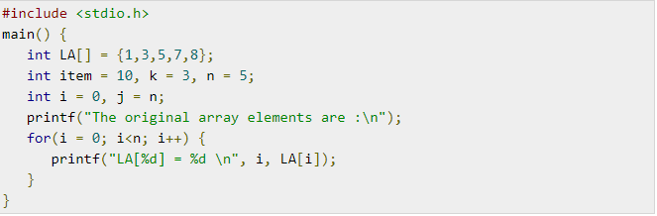
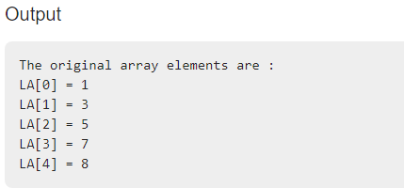
Traversal

Slide 24
Insertion
Insert an element in array

Slide 25
Note
If the position where the element to be inserted is greater than the size of an array display Invalid Input.

Slide 26
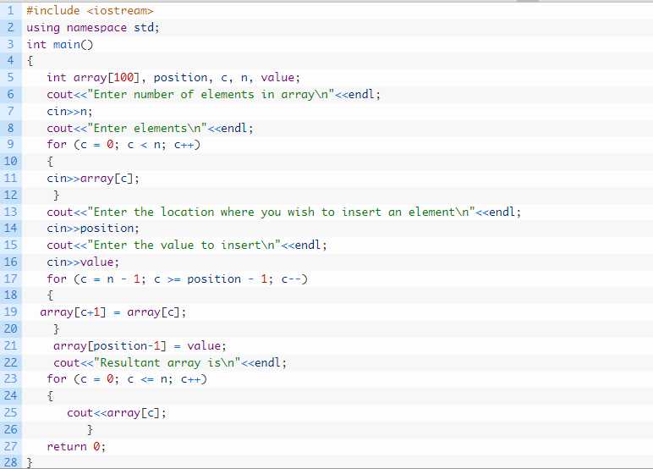
Insertion

Slide 27
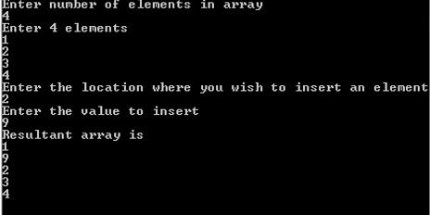
Output

Slide 28
Deletion
Delete an element from an array

Slide 29
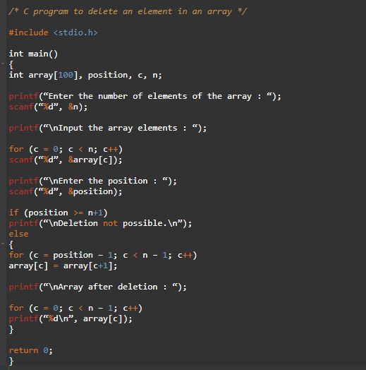

Slide 30

Deletion
Output

Slide 31
Searching
Search an element in an array

Slide 32
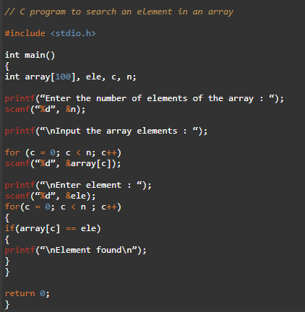

Slide 33
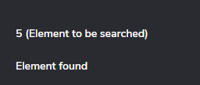
Searching
Output

Slide 34
Arrays
Some More Examples

Slide 35
1 /* Fig. 6.8: fig06_08.c
2 Histogram printing program */
3 #include <stdio.h>
4 #define SIZE 10
1. Initialize array
2. Loop
3. Print
5
6 int main()
7 {
8 int n[ SIZE ] = { 19, 3, 15, 7, 11, 9, 13, 5, 17, 1 };
9 int i, j;
10
11 printf( "%s%13s%17s\n", "Element", "Value", "Histogram" );
12
13 for ( i = 0; i <= SIZE - 1; i++ ) {
14 printf( "%7d%13d ", i, n[ i ]) ;
15
16 for ( j = 1; j <= n[ i ]; j++ ) /* print one bar */
17 printf( "%c", '*' );
18
19 printf( "\n" );
20 }
21
22 return 0;
23 }

Slide 36
Element Value Histogram
0 19 *******************
1 3 ***
2 15 ***************
3 7 *******
4 11 ***********
5 9 *********
6 13 *************
7 5 *****
8 17 *****************
9 1 *
Program Output

Slide 37
Summary
Any Questions?

